Slide 1



COASTAL THREAT ALERT SYSTEM
By THE DEBUGGERS
JEEL SHAH
HADI BHOJANI
HARD PATEL
SWAYAM PATEL

Slide 2
AGENDA
Project overview & goals
File structure and requirements
How the single-file MVP works
Key code sections explained (synthetic data, ML, alerting, API)
How to run and demo

Slide 3

PROJECT OVERVIEW
Real-time early warning for coastal threats: storm surge, erosion, pollution
MVP runs a simulated sensor stream + anomaly detection + alerts (SMS optional)
Target users: disaster managers, local authorities, fisherfolk, NGOs

Slide 4
TOOLS
Python
Dependencies: fastapi, uvicorn, scikit-learn, numpy
Optional: twilio (for SMS)
Run with: uvicorn main:app --reload

Slide 5

High-level Flow
Synthetic historical data → train IsolationForest
(ML anomaly detector)
2) Background thread simulates sensor readings (tide, wind, pollution)
3) Each reading -> model + simple threshold checks → decide anomaly
4) If alert -> add to in-memory alerts list and optionally send SMS
5) FastAPI endpoints serve dashboard HTML, /data, /alerts

Slide 6
Proposed Solution
Data Integration: Collect info from physical sensors (tide gauges, weather stations), satellites, and historical records.
AI/ML Analysis: Spot anomalies & patterns (e.g., unusual tide spikes, water discoloration from algae, pollution signals).
Multi-Channel Alerts: Send timely warnings through:
SMS 📱 (for fishermen & coastal residents)
Mobile App Notifications 🔔 (real-time push alerts)
Web Dashboards 📊 (for authorities & decision makers)

Slide 7
System Architecture
1. Data Collection
Real-time sensor data: Tide gauges, weather stations, water quality sensors
2. Data Processing & Storage
Cloud-based database (e.g., AWS, Azure, GCP)
3. AI/ML Analysis
Anomaly Detection (Isolation Forest, Z-score, etc.)
4. Alerts & Visualization
SMS & app notifications
Real-time dashboard with:

Slide 8
\
STEP BY STEP APPROACH
1️⃣ Define Scope
Start small: e.g., only detect storm surges first, then add pollution & algal blooms.
2️⃣ Collect Data
Use open APIs: NOAA, NASA EarthData, Copernicus satellites
Download historical climate & tide datasets
3️⃣ Build Data Pipeline
Write scripts to fetch & clean data
Store in structured database
4️⃣ Train AI/ML Models
Detect anomalies (sudden sea rise, unusual water readings)
Forecast future risks

Slide 9
\
STEP BY STEP APPROACH
5️⃣ Develop Alert System
Use APIs like Twilio (SMS), Firebase (push notifications)
Connect triggers to alerts
6️⃣ Build Dashboard
Create web app (React, Node.js, or Python Flask + D3.js for charts)
Show real-time monitoring & alerts
7️⃣ Testing & Scaling
Simulate storm/algae scenarios to check alerts
Expand to integrate more threats

Slide 10
\
Impact & Benefits
🌍 Environmental Protection
Safeguards coastal ecosystems, mangroves, seagrass beds
🚨 Disaster Preparedness
Timely alerts save lives & reduce property loss
📊 Data-Driven Governance
Authorities can act based on real evidence & forecasts
🤝 Community Resilience
Fishermen, coastal residents get early alerts, reducing vulnerability
✅ Scalable & Adaptable
Can expand from local to global level
Modular: start with storms → add pollution → add illegal activities

Slide 11
\
Conclusion: Why Our Solution Matters
🚨 Early Detection Saves Lives – Alerts before disasters strike.
🌍 Protects Blue Carbon – Safeguards mangroves, seagrass & climate.
📊 Data-Driven Decisions – Real-time dashboards for authorities.
🤝 Tech + Community – AI/ML & IoT directly benefit coastal people.
🔄 Scalable & Adaptable – Expandable to multiple threats, global use.
💡 Hackathon Value – Innovative, impactful, and interdisciplinary.

Slide 12
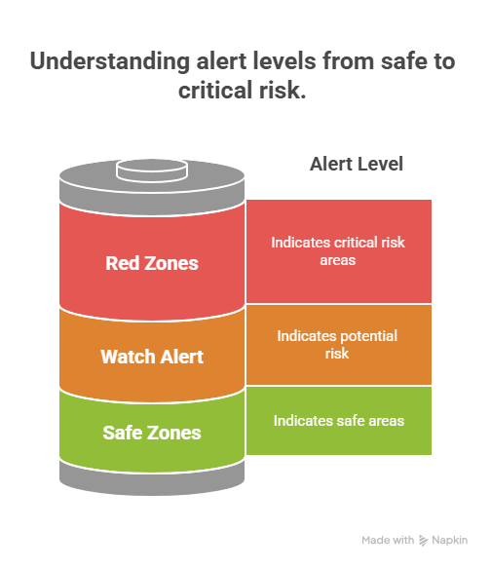

Slide 13
THANK YOU

